Slide 1
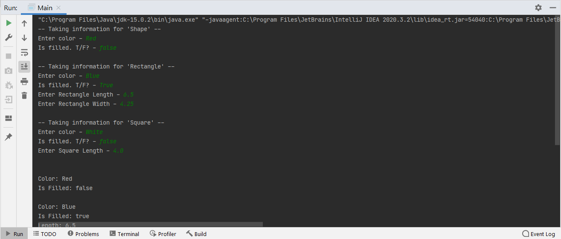
LabAssignment6_Part1_2014310

Slide 2
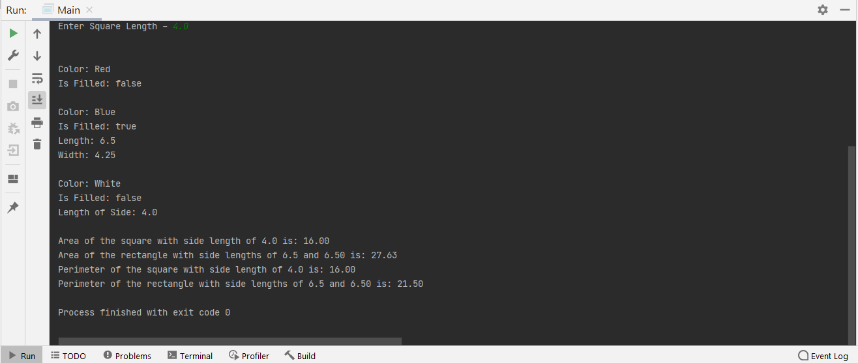
LabAssignment6_Part2_2014310

